Slide 1

Classification (Ensemble Methods) Part 2 : Boosting Gradient Boosted Trees
by:
Eng. Alaa Al Nissany

Slide 2
Machine Learning
Supervised Learning
Unsupervised Learning
Reinforcement Learning
Classification
Clustering
Q-Learning
Regression
Anomaly Detection
DQN
Ranking
Dimensionality reduction

Slide 3
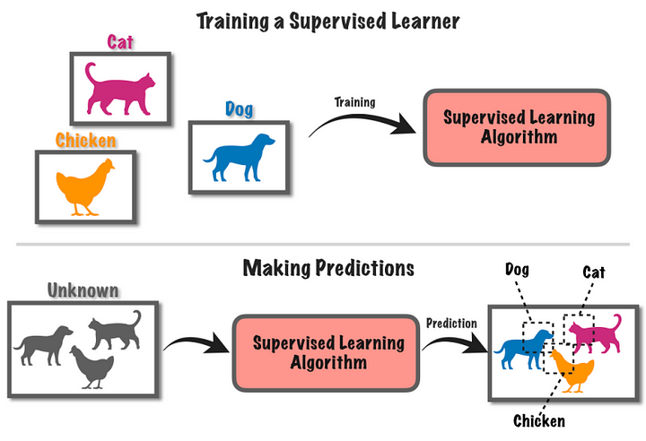
Supervised Learning

Slide 4
Ensemble Learning
Bagging
Boosting
Stacking

Slide 5

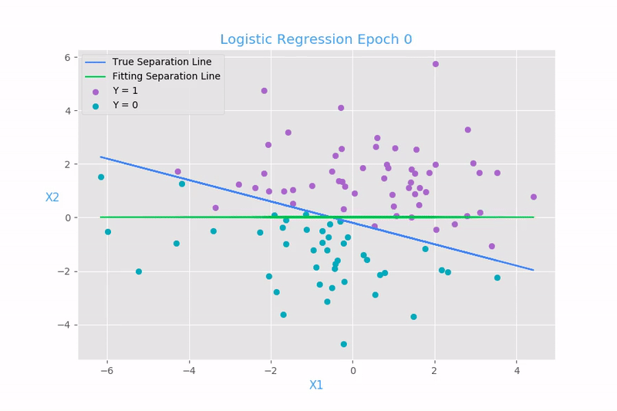

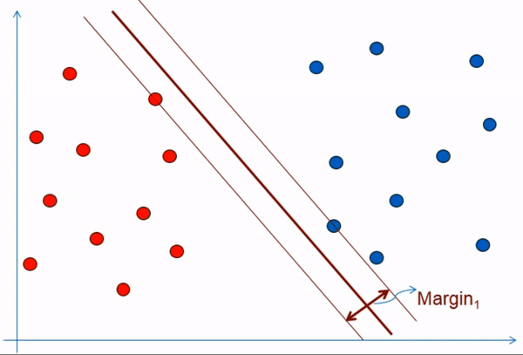

Bagging
Data Bootstrapping
Predictions
Final Prediction
Voting
Data
OR
Prediction Aggregation

Slide 6
Some Famous Bagging algorithms
Random Forest | EXTRA Trees
Optimized Bagging classifier on Decision Tree | Random Forest with splitting the subset of the data in every node by selecting a random thresholds for each feature in each node
Bagging algorithms trade more bias for lower variance

Slide 7
Ensemble Learning
Bagging
Boosting
Stacking

Slide 8
Boosting

Slide 9
AdaBoost

Slide 10
Gradient Boosted Trees

Slide 11
Gradient Boosted Trees
Animal | Color | Size | Cuteness
Dog | Brown | Small | Medium
Cat | Brown | Small | Medium
Dog | Brown | Small | High
Cat | Gold | Medium | High
Cat | Black | Medium | High
Dog | Gold | Small | Medium
Cat | Brown | Medium | Low
Dog | Gold | Large | High
Cat | Brown | Medium | Medium
Dog | Black | Large | High
Cat | Gold | Large | Medium
Cat | Brown | Small | High

Slide 12
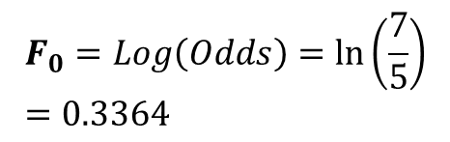

Gradient Boosted Trees
Step 1
Animal | Color | Size | Cuteness
0 | Brown | Small | Medium
1 | Brown | Small | Medium
0 | Brown | Small | High
1 | Gold | Medium | High
1 | Black | Medium | High
0 | Gold | Small | Medium
1 | Brown | Medium | Low
0 | Gold | Large | High
1 | Brown | Medium | Medium
0 | Black | Large | High
1 | Gold | Large | Medium
1 | Brown | Small | High
Calculate the Log(Odds) $F_{0}$of the Whole Dataset for the Initial Leaf
5 | 7
$$F_{0}=Log\left(Odds\right)=\ln\left(\frac{7}{5}\right)=0.3364$$

Slide 13

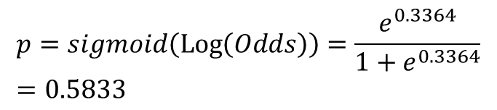

Gradient Boosted Trees
Step 1
Animal | Color | Size | Cuteness
0 | Brown | Small | Medium
1 | Brown | Small | Medium
0 | Brown | Small | High
1 | Gold | Medium | High
1 | Black | Medium | High
0 | Gold | Small | Medium
1 | Brown | Medium | Low
0 | Gold | Large | High
1 | Brown | Medium | Medium
0 | Black | Large | High
1 | Gold | Large | Medium
1 | Brown | Small | High
Calculate the Log(Odds) $F_{0}$of the Whole Dataset for the Initial Leaf
$$F_{0} \\ 0.3364$$
$$p=sigmoid\left(\operatorname{Log}\left(Odds\right)\right)=\frac{e^{0.3364}}{1+e^{0.3364}}=0.5833$$

Slide 14

Gradient Boosted Trees
Step 1
Animal | Color | Size | Cuteness
0 | Brown | Small | Medium
1 | Brown | Small | Medium
0 | Brown | Small | High
1 | Gold | Medium | High
1 | Black | Medium | High
0 | Gold | Small | Medium
1 | Brown | Medium | Low
0 | Gold | Large | High
1 | Brown | Medium | Medium
0 | Black | Large | High
1 | Gold | Large | Medium
1 | Brown | Small | High
Calculate the Log(Odds) $F_{0}$of the Whole Dataset for the Initial Leaf
The probability of being a Cat
$$F_{0} \\ 0.3364$$
$$p=sigmoid\left(\operatorname{Log}\left(Odds\right)\right)=\frac{e^{0.3364}}{1+e^{0.3364}}=0.5833$$

Slide 15
Gradient Boosted Trees
Animal | Color | Size | Cuteness
0 | Brown | Small | Medium
1 | Brown | Small | Medium
0 | Brown | Small | High
1 | Gold | Medium | High
1 | Black | Medium | High
0 | Gold | Small | Medium
1 | Brown | Medium | Low
0 | Gold | Large | High
1 | Brown | Medium | Medium
0 | Black | Large | High
1 | Gold | Large | Medium
1 | Brown | Small | High
Step 2
Calculate the Residuals
$$r_{0,j}=Target value−predicted value$$

Slide 16
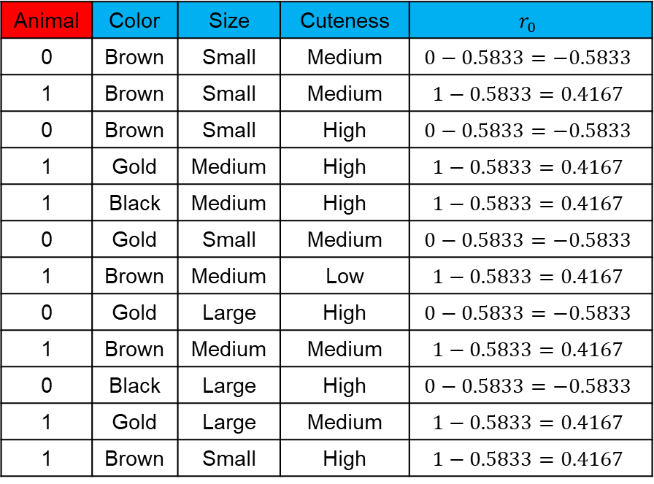
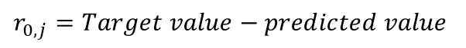
Gradient Boosted Trees
Animal | Color | Size | Cuteness | $$r_{0}$$
0 | Brown | Small | Medium | $$0−0.5833=−0.5833$$
1 | Brown | Small | Medium | $$1−0.5833=0.4167$$
0 | Brown | Small | High | $$0−0.5833=−0.5833$$
1 | Gold | Medium | High | $$1−0.5833=0.4167$$
1 | Black | Medium | High | $$1−0.5833=0.4167$$
0 | Gold | Small | Medium | $$0−0.5833=−0.5833$$
1 | Brown | Medium | Low | $$1−0.5833=0.4167$$
0 | Gold | Large | High | $$0−0.5833=−0.5833$$
1 | Brown | Medium | Medium | $$1−0.5833=0.4167$$
0 | Black | Large | High | $$0−0.5833=−0.5833$$
1 | Gold | Large | Medium | $$1−0.5833=0.4167$$
1 | Brown | Small | High | $$1−0.5833=0.4167$$
Step 2
Calculate the Residuals
$$r_{0,j}=Target value−predicted value$$

Slide 17
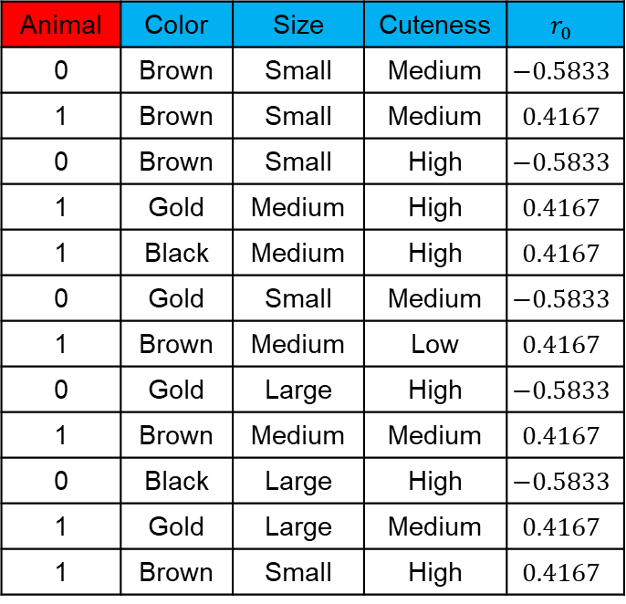
New Target
Gradient Boosted Trees
Step 3
Build the Regression Tree to predict the residual (New Target)
Animal | Color | Size | Cuteness | $$r_{0}$$
0 | Brown | Small | Medium | $$−0.5833$$
1 | Brown | Small | Medium | $$0.4167$$
0 | Brown | Small | High | $$−0.5833$$
1 | Gold | Medium | High | $$0.4167$$
1 | Black | Medium | High | $$0.4167$$
0 | Gold | Small | Medium | $$−0.5833$$
1 | Brown | Medium | Low | $$0.4167$$
0 | Gold | Large | High | $$−0.5833$$
1 | Brown | Medium | Medium | $$0.4167$$
0 | Black | Large | High | $$−0.5833$$
1 | Gold | Large | Medium | $$0.4167$$
1 | Brown | Small | High | $$0.4167$$
0.4167, 0.4167, 0.4167, 0.4167
S
M
L
Size
Color
G
B
M
H
Cuteness
-0.5833
0.4167,-0.5833, 0.4167,-0.5833
0.4167
-0.5833

Slide 18
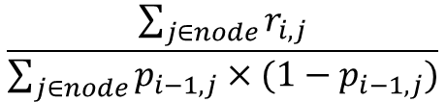
New Target
Gradient Boosted Trees
Step 4
Transform the residuals in the Tree
Animal | Color | Size | Cuteness | $$r_{0}$$
0 | Brown | Small | Medium | $$−0.5833$$
1 | Brown | Small | Medium | $$0.4167$$
0 | Brown | Small | High | $$−0.5833$$
1 | Gold | Medium | High | $$0.4167$$
1 | Black | Medium | High | $$0.4167$$
0 | Gold | Small | Medium | $$−0.5833$$
1 | Brown | Medium | Low | $$0.4167$$
0 | Gold | Large | High | $$−0.5833$$
1 | Brown | Medium | Medium | $$0.4167$$
0 | Black | Large | High | $$−0.5833$$
1 | Gold | Large | Medium | $$0.4167$$
1 | Brown | Small | High | $$0.4167$$
$$\frac{\sum_{j∈node}{r_{i,j}}}{\sum_{j∈node}{p_{i−1,j}×(1−p_{i−1,j})}}$$
0.4167, 0.4167, 0.4167, 0.4167
S
M
L
Size
Color
G
B
M
H
Cuteness
-0.5833
0.4167,-0.5833, 0.4167,-0.5833
0.4167
-0.5833

Slide 19
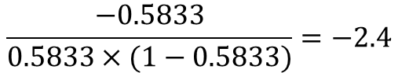
New Target
Gradient Boosted Trees
Step 4
Transform the residuals in the Tree
Animal | Color | Size | Cuteness | $$r_{0}$$
0 | Brown | Small | Medium | $$−0.5833$$
1 | Brown | Small | Medium | $$0.4167$$
0 | Brown | Small | High | $$−0.5833$$
1 | Gold | Medium | High | $$0.4167$$
1 | Black | Medium | High | $$0.4167$$
0 | Gold | Small | Medium | $$−0.5833$$
1 | Brown | Medium | Low | $$0.4167$$
0 | Gold | Large | High | $$−0.5833$$
1 | Brown | Medium | Medium | $$0.4167$$
0 | Black | Large | High | $$−0.5833$$
1 | Gold | Large | Medium | $$0.4167$$
1 | Brown | Small | High | $$0.4167$$
$$\frac{−0.5833}{0.5833×(1−0.5833)}=−2.4$$
0.4167, 0.4167, 0.4167, 0.4167
S
M
L
Size
Color
G
B
M
H
Cuteness
-0.5833
0.4167,-0.5833, 0.4167,-0.5833
0.4167
-0.5833

Slide 20
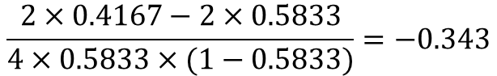
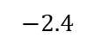
New Target
Gradient Boosted Trees
Step 4
Transform the residuals in the Tree
Animal | Color | Size | Cuteness | $$r_{0}$$
0 | Brown | Small | Medium | $$−0.5833$$
1 | Brown | Small | Medium | $$0.4167$$
0 | Brown | Small | High | $$−0.5833$$
1 | Gold | Medium | High | $$0.4167$$
1 | Black | Medium | High | $$0.4167$$
0 | Gold | Small | Medium | $$−0.5833$$
1 | Brown | Medium | Low | $$0.4167$$
0 | Gold | Large | High | $$−0.5833$$
1 | Brown | Medium | Medium | $$0.4167$$
0 | Black | Large | High | $$−0.5833$$
1 | Gold | Large | Medium | $$0.4167$$
1 | Brown | Small | High | $$0.4167$$
$$\frac{2×0.4167−2×0.5833}{4×0.5833×(1−0.5833)}=−0.343$$
0.4167, 0.4167, 0.4167, 0.4167
S
M
L
Size
Color
G
B
M
H
Cuteness
$$−2.4$$
0.4167,-0.5833, 0.4167,-0.5833
0.4167
-0.5833

Slide 21
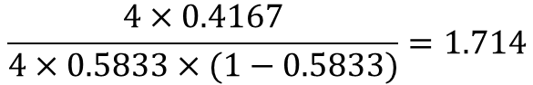

New Target
Gradient Boosted Trees
Step 4
Transform the residuals in the Tree
Animal | Color | Size | Cuteness | $$r_{0}$$
0 | Brown | Small | Medium | $$−0.5833$$
1 | Brown | Small | Medium | $$0.4167$$
0 | Brown | Small | High | $$−0.5833$$
1 | Gold | Medium | High | $$0.4167$$
1 | Black | Medium | High | $$0.4167$$
0 | Gold | Small | Medium | $$−0.5833$$
1 | Brown | Medium | Low | $$0.4167$$
0 | Gold | Large | High | $$−0.5833$$
1 | Brown | Medium | Medium | $$0.4167$$
0 | Black | Large | High | $$−0.5833$$
1 | Gold | Large | Medium | $$0.4167$$
1 | Brown | Small | High | $$0.4167$$
$$\frac{4×0.4167}{4×0.5833×(1−0.5833)}=1.714$$
0.4167, 0.4167, 0.4167, 0.4167
S
M
L
Size
Color
G
B
M
H
Cuteness
$$−2.4$$
$$−0.343$$
0.4167
-0.5833

Slide 22
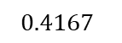
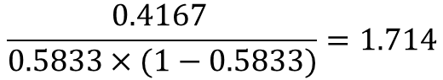

New Target
Gradient Boosted Trees
Step 4
Transform the residuals in the Tree
Animal | Color | Size | Cuteness | $$r_{0}$$
0 | Brown | Small | Medium | $$−0.5833$$
1 | Brown | Small | Medium | $$0.4167$$
0 | Brown | Small | High | $$−0.5833$$
1 | Gold | Medium | High | $$0.4167$$
1 | Black | Medium | High | $$0.4167$$
0 | Gold | Small | Medium | $$−0.5833$$
1 | Brown | Medium | Low | $$0.4167$$
0 | Gold | Large | High | $$−0.5833$$
1 | Brown | Medium | Medium | $$0.4167$$
0 | Black | Large | High | $$−0.5833$$
1 | Gold | Large | Medium | $$0.4167$$
1 | Brown | Small | High | $$0.4167$$
$$\frac{\text{0.4167} }{0.5833×(1−0.5833)}=1.714$$
$$1.714$$
S
M
L
Size
Color
G
B
M
H
Cuteness
$$−2.4$$
$$−0.343$$
$$0.4167$$
-0.5833

Slide 23
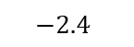
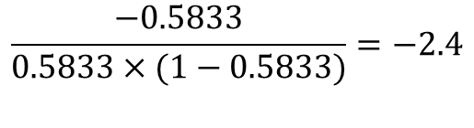
New Target
Gradient Boosted Trees
Step 4
Transform the residuals in the Tree
Animal | Color | Size | Cuteness | $$r_{0}$$
0 | Brown | Small | Medium | $$−0.5833$$
1 | Brown | Small | Medium | $$0.4167$$
0 | Brown | Small | High | $$−0.5833$$
1 | Gold | Medium | High | $$0.4167$$
1 | Black | Medium | High | $$0.4167$$
0 | Gold | Small | Medium | $$−0.5833$$
1 | Brown | Medium | Low | $$0.4167$$
0 | Gold | Large | High | $$−0.5833$$
1 | Brown | Medium | Medium | $$0.4167$$
0 | Black | Large | High | $$−0.5833$$
1 | Gold | Large | Medium | $$0.4167$$
1 | Brown | Small | High | $$0.4167$$
$$\frac{−0.5833}{0.5833×(1−0.5833)}=−2.4$$
$$1.714$$
S
M
L
Size
Color
G
B
M
H
Cuteness
$$−2.4$$
$$−0.343$$
1.714
$$−2.4$$

Slide 24
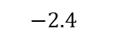

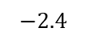
New Target
Gradient Boosted Trees
Step 4
Transform the residuals in the Tree
Animal | Color | Size | Cuteness | $$r_{0}$$
0 | Brown | Small | Medium | $$−0.5833$$
1 | Brown | Small | Medium | $$0.4167$$
0 | Brown | Small | High | $$−0.5833$$
1 | Gold | Medium | High | $$0.4167$$
1 | Black | Medium | High | $$0.4167$$
0 | Gold | Small | Medium | $$−0.5833$$
1 | Brown | Medium | Low | $$0.4167$$
0 | Gold | Large | High | $$−0.5833$$
1 | Brown | Medium | Medium | $$0.4167$$
0 | Black | Large | High | $$−0.5833$$
1 | Gold | Large | Medium | $$0.4167$$
1 | Brown | Small | High | $$0.4167$$
S
M
L
$$1.714$$
G
B
M
H
$$−2.4$$
$$−0.343$$
1.714
$$−2.4$$

Slide 25



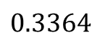
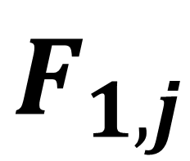
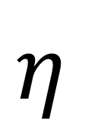
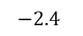
Gradient Boosted Trees
Compute the new log(Odds) prediction $F_{1}$ for each sample
Step 5
$F_{0}$
Index of a sample
$F_{1,j}$
$$η$$
S
M
L
$$1.714$$
$$0.3364$$
G
B
M
H
Learning rate
$$−2.4$$
$$−0.343$$
1.714
$$−2.4$$

Slide 26
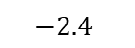


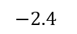

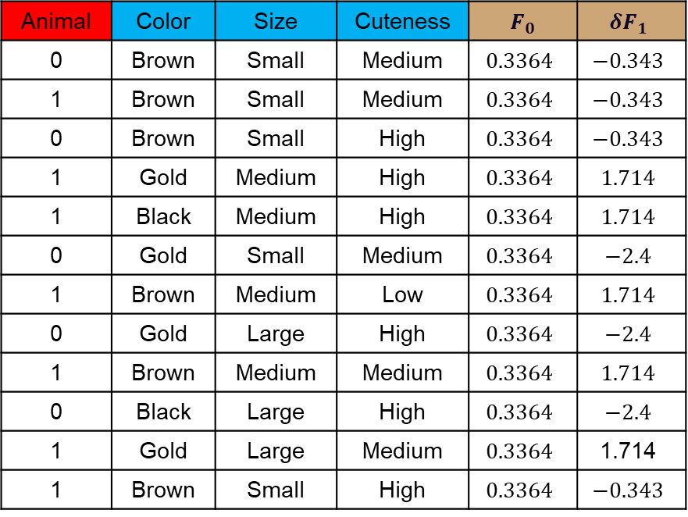
Gradient Boosted Trees
Step 5
Animal | Color | Size | Cuteness | $F_{0}$ | $${δF}_{1}$$
0 | Brown | Small | Medium | $$0.3364$$ | $$−0.343$$
1 | Brown | Small | Medium | $$0.3364$$ | $$−0.343$$
0 | Brown | Small | High | $$0.3364$$ | $$−0.343$$
1 | Gold | Medium | High | $$0.3364$$ | $$1.714$$
1 | Black | Medium | High | $$0.3364$$ | $$1.714$$
0 | Gold | Small | Medium | $$0.3364$$ | $$−2.4$$
1 | Brown | Medium | Low | $$0.3364$$ | $$1.714$$
0 | Gold | Large | High | $$0.3364$$ | $$−2.4$$
1 | Brown | Medium | Medium | $$0.3364$$ | $$1.714$$
0 | Black | Large | High | $$0.3364$$ | $$−2.4$$
1 | Gold | Large | Medium | $$0.3364$$ | $$\text{1}\text{.}\text{714}$$
1 | Brown | Small | High | $$0.3364$$ | $$−0.343$$
Compute the new log(Odds) prediction $F_{1}$ for each sample
S
M
L
$$1.714$$
G
B
M
H
$$−2.4$$
$$−0.343$$
1.714
$$−2.4$$

Slide 27
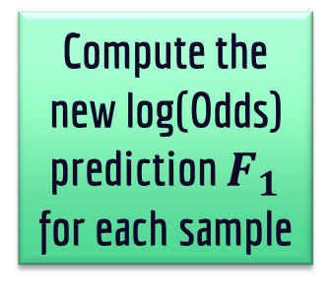
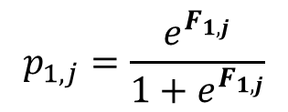
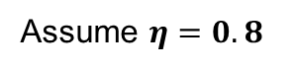
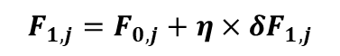
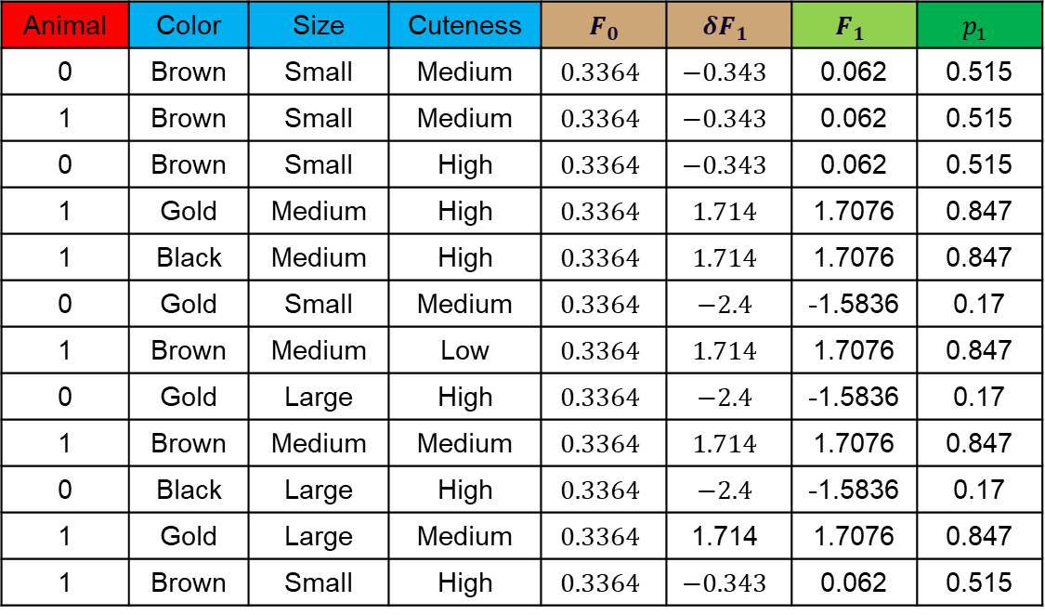
Gradient Boosted Trees
Step 5
Animal | Color | Size | Cuteness | $F_{0}$ | $${δF}_{1}$$ | $$F_{1}$$ | $$p_{1}$$
0 | Brown | Small | Medium | $$0.3364$$ | $$−0.343$$ | 0.062 | 0.515
1 | Brown | Small | Medium | $$0.3364$$ | $$−0.343$$ | 0.062 | 0.515
0 | Brown | Small | High | $$0.3364$$ | $$−0.343$$ | 0.062 | 0.515
1 | Gold | Medium | High | $$0.3364$$ | $$1.714$$ | 1.7076 | 0.847
1 | Black | Medium | High | $$0.3364$$ | $$1.714$$ | 1.7076 | 0.847
0 | Gold | Small | Medium | $$0.3364$$ | $$−2.4$$ | -1.5836 | 0.17
1 | Brown | Medium | Low | $$0.3364$$ | $$1.714$$ | 1.7076 | 0.847
0 | Gold | Large | High | $$0.3364$$ | $$−2.4$$ | -1.5836 | 0.17
1 | Brown | Medium | Medium | $$0.3364$$ | $$1.714$$ | 1.7076 | 0.847
0 | Black | Large | High | $$0.3364$$ | $$−2.4$$ | -1.5836 | 0.17
1 | Gold | Large | Medium | $$0.3364$$ | $$\text{1.714}$$ | 1.7076 | 0.847
1 | Brown | Small | High | $$0.3364$$ | $$−0.343$$ | 0.062 | 0.515
Compute the new log(Odds) prediction $F_{1}$ for each sample
$$F_{1,j}=F_{0,j}+η{×δF}_{1,j}$$
Assume $η=0.8$
$$p_{1,j}=\frac{e^{F_{1,j}}}{1+e^{F_{1,j}}}$$

Slide 28
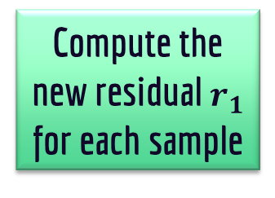
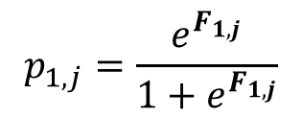
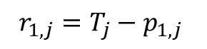
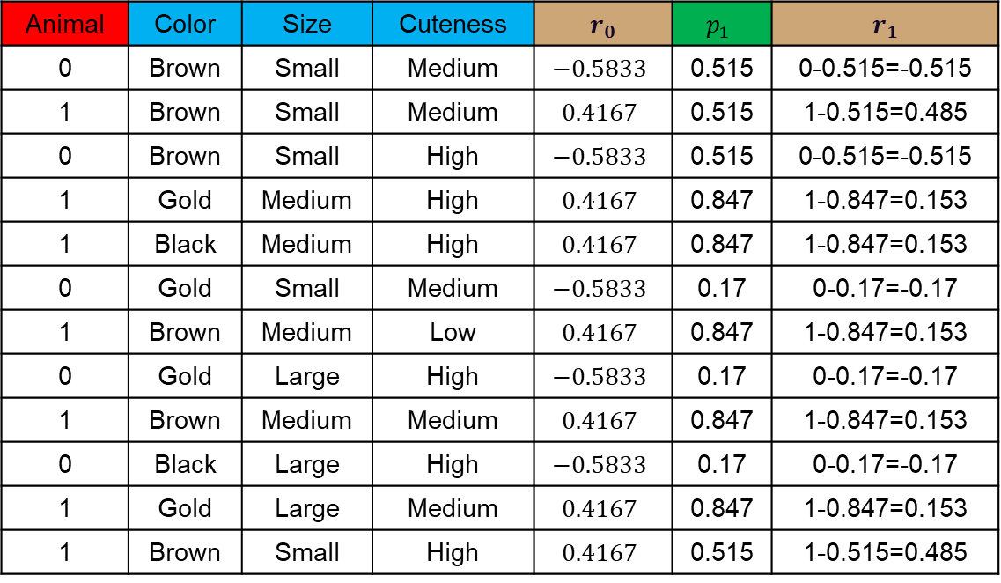
Gradient Boosted Trees
Step 6
Animal | Color | Size | Cuteness | $r_{0}$ | $$p_{1}$$ | $r_{1}$
0 | Brown | Small | Medium | $$−0.5833$$ | 0.515 | 0-0.515=-0.515
1 | Brown | Small | Medium | $$0.4167$$ | 0.515 | 1-0.515=0.485
0 | Brown | Small | High | $$−0.5833$$ | 0.515 | 0-0.515=-0.515
1 | Gold | Medium | High | $$0.4167$$ | 0.847 | 1-0.847=0.153
1 | Black | Medium | High | $$0.4167$$ | 0.847 | 1-0.847=0.153
0 | Gold | Small | Medium | $$−0.5833$$ | 0.17 | 0-0.17=-0.17
1 | Brown | Medium | Low | $$0.4167$$ | 0.847 | 1-0.847=0.153
0 | Gold | Large | High | $$−0.5833$$ | 0.17 | 0-0.17=-0.17
1 | Brown | Medium | Medium | $$0.4167$$ | 0.847 | 1-0.847=0.153
0 | Black | Large | High | $$−0.5833$$ | 0.17 | 0-0.17=-0.17
1 | Gold | Large | Medium | $$0.4167$$ | 0.847 | 1-0.847=0.153
1 | Brown | Small | High | $$0.4167$$ | 0.515 | 1-0.515=0.485
Compute the new residual $r_{1}$ for each sample
$$p_{1,j}=\frac{e^{F_{1,j}}}{1+e^{F_{1,j}}}$$
$$r_{1,j}=T_{j}−p_{1,j}$$

Slide 29
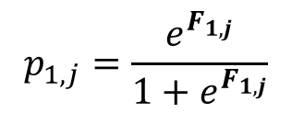

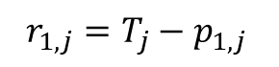
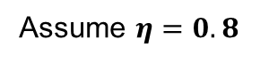
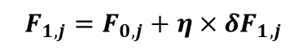
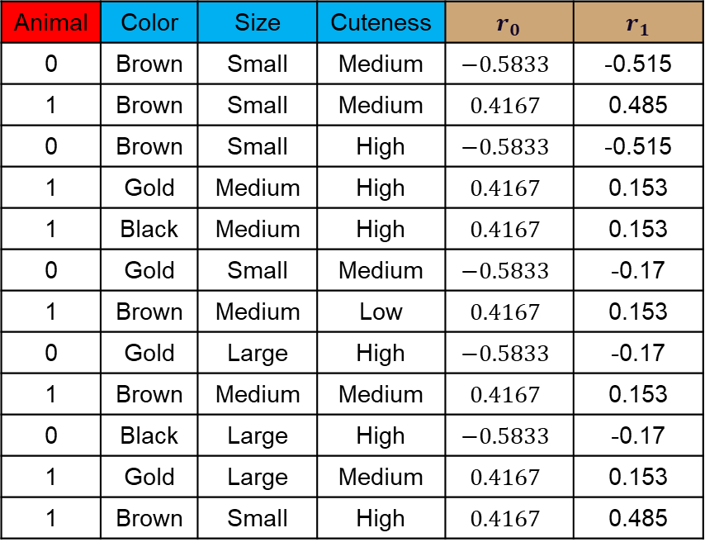
Gradient Boosted Trees
Step 6
Animal | Color | Size | Cuteness | $r_{0}$ | $r_{1}$
0 | Brown | Small | Medium | $$−0.5833$$ | -0.515
1 | Brown | Small | Medium | $$0.4167$$ | 0.485
0 | Brown | Small | High | $$−0.5833$$ | -0.515
1 | Gold | Medium | High | $$0.4167$$ | 0.153
1 | Black | Medium | High | $$0.4167$$ | 0.153
0 | Gold | Small | Medium | $$−0.5833$$ | -0.17
1 | Brown | Medium | Low | $$0.4167$$ | 0.153
0 | Gold | Large | High | $$−0.5833$$ | -0.17
1 | Brown | Medium | Medium | $$0.4167$$ | 0.153
0 | Black | Large | High | $$−0.5833$$ | -0.17
1 | Gold | Large | Medium | $$0.4167$$ | 0.153
1 | Brown | Small | High | $$0.4167$$ | 0.485
Compute the new residual $r_{1}$ for each sample
$$F_{1,j}=F_{0,j}+η{×δF}_{1,j}$$
Assume $η=0.8$
$$p_{1,j}=\frac{e^{F_{1,j}}}{1+e^{F_{1,j}}}$$
$$r_{1,j}=T_{j}−p_{1,j}$$

Slide 30
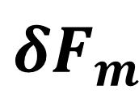
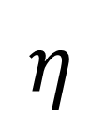
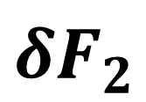
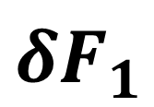

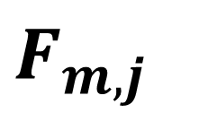
Gradient Boosted Trees
Step 7
$${δF}_{1}$$
Repeat from step 3
$${δF}_{2}$$
$$F_{0}$$
$F_{m,j}$
$$η$$
$${δF}_{m}$$

Slide 31
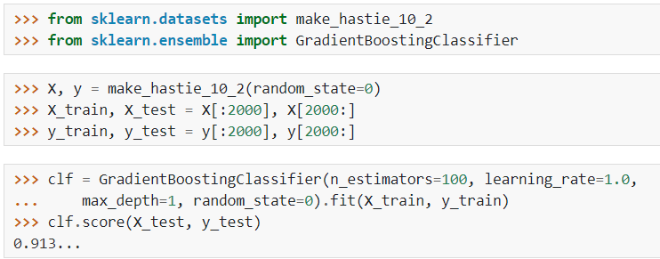
Gradient Boosting Classifier Using SkLearn
https://scikit-learn.org/stable/modules/generated/sklearn.ensemble.GradientBoostingClassifier.html

Slide 32
Important parameters
estimator | The base classifier
n_estimators | The Number of base estimators in the ensemble.
learning_rate | hyperparameter shrinks the contribution of each tree.
validation_fraction | The proportion of training data to set aside as validation set for early stopping.
n_iter_no_change | used to decide if early stopping will be used to terminate training when validation score is not improving.
tol | Tolerance for the early stopping.
https://scikit-learn.org/stable/modules/generated/sklearn.ensemble.AdaBoostClassifier.html

Slide 33
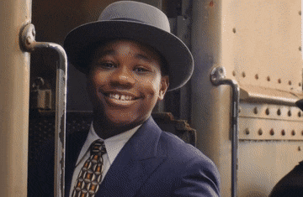
Thank you for listening

Slide 34
Any Questions
?

